Slide 1
Find today’s quiz #2 at http://www.humanaiclass.org/
History of Artificial Intelligence

Slide 2
Outline
0BC - 1956 Prehistory of Artificial Intelligence
1956 - 1974 First Artificial Intelligence Spring
Break for Activities
1980 - 1987 Second Artificial Intelligence Spring
Break for Activities
2011 - Present Third Artificial Intelligence Spring
Readings & Panels

Slide 3
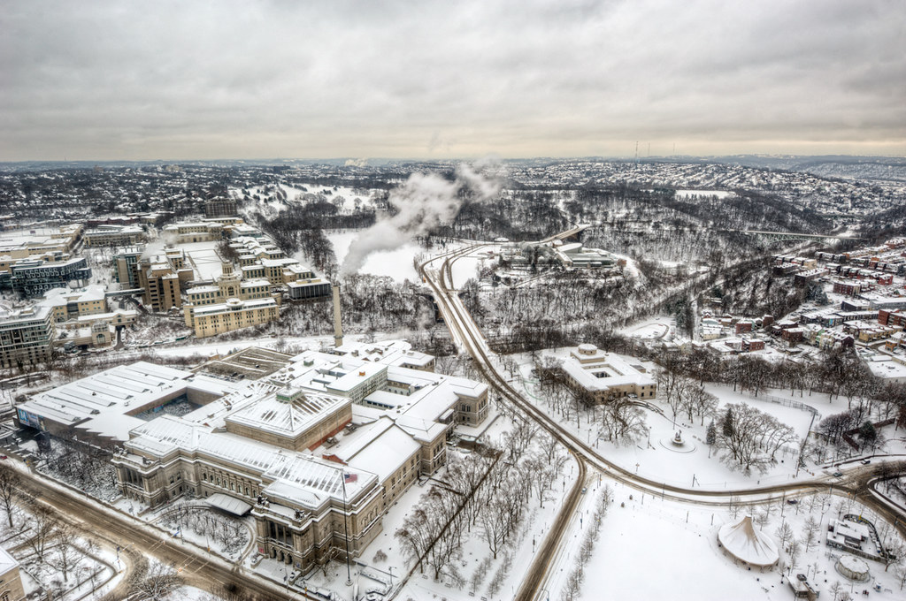
Artificial Intelligence comes in waves of hype
AI Spring is a time period when new technology prompts a period of intense funding and research around AI
A breaking point where expectations fail to meet reality
AI Winter is a time period when much lower funding is given to AI and research is slower or more incremental.

Slide 4
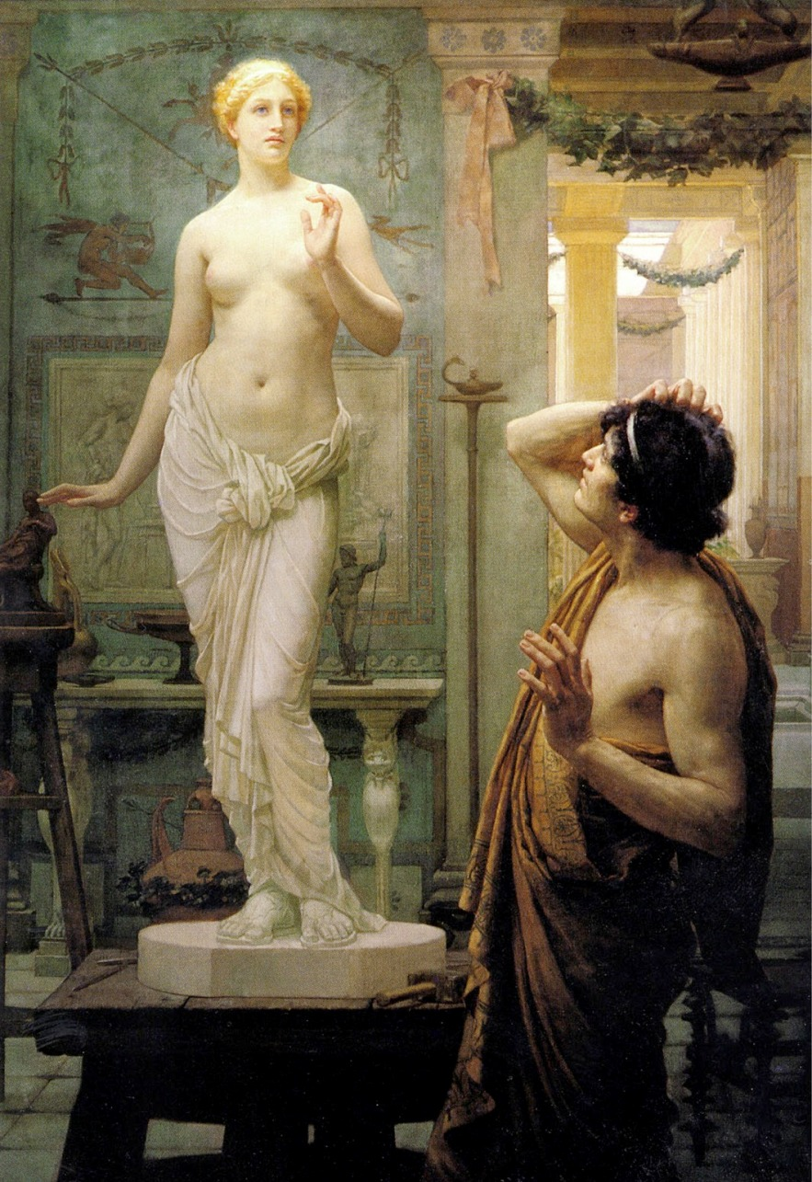
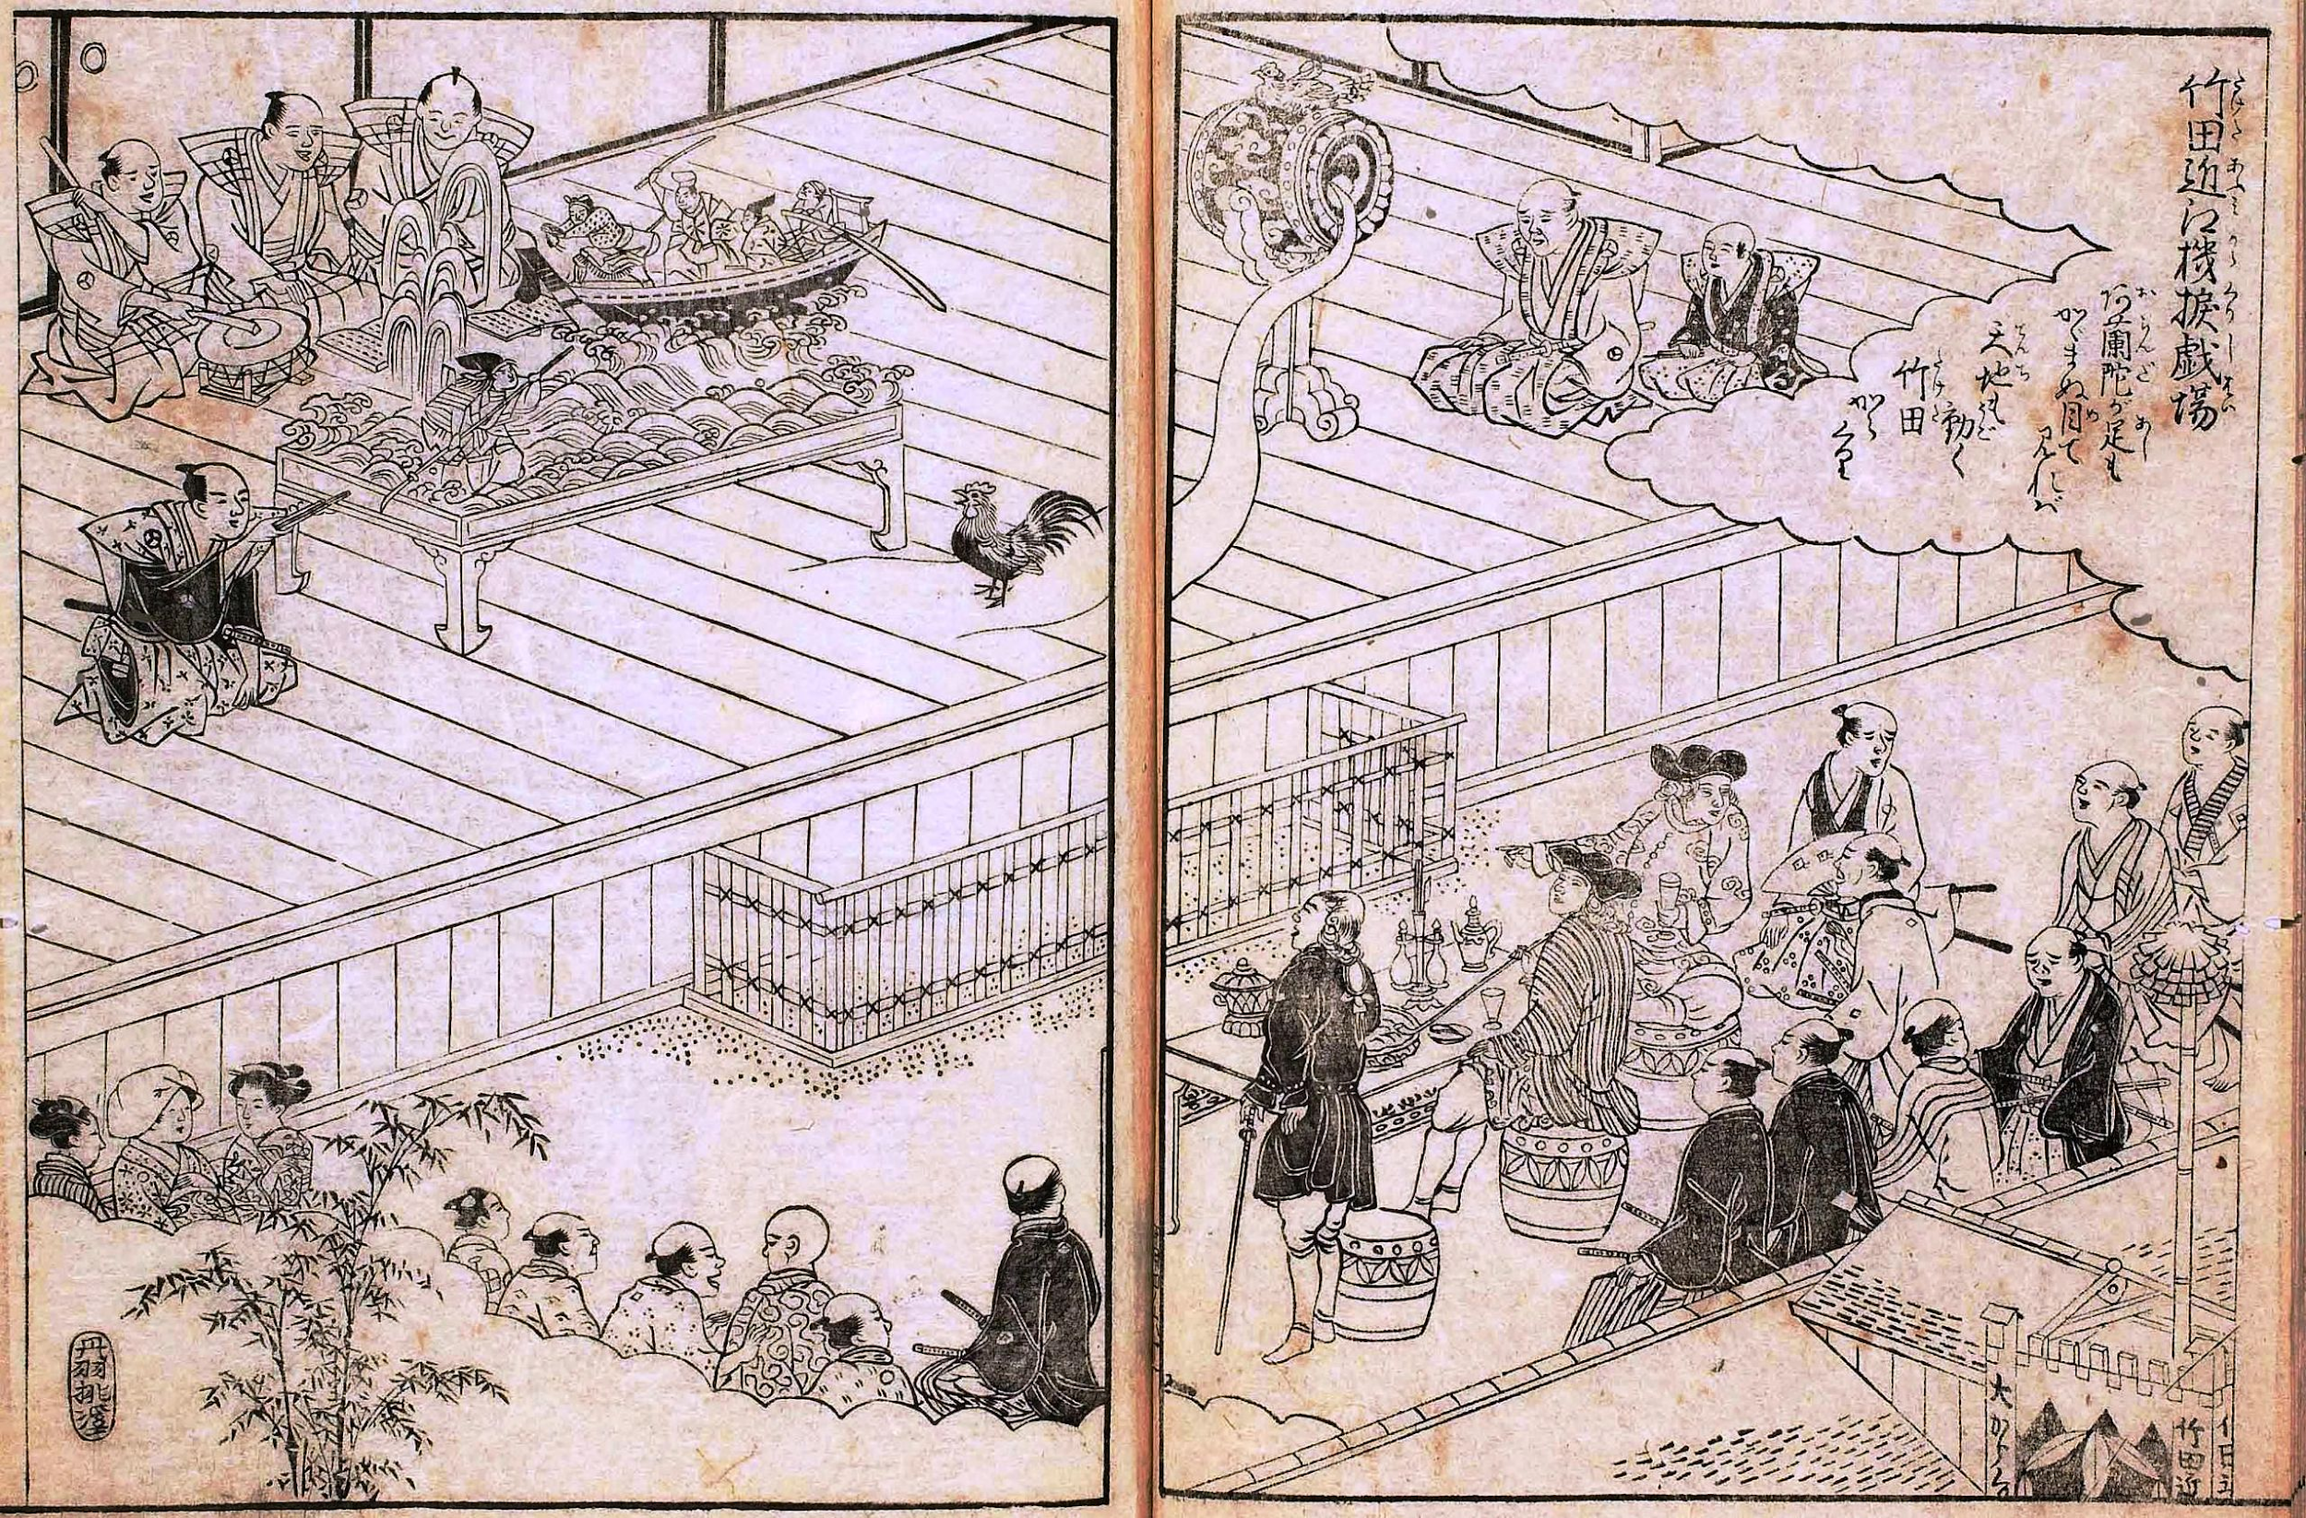
Ancient automaton
“... by discovering the true nature of the gods, man has been able to reproduce it." - maybe some guy named Hermes Trismegistus < 200 BC
Automaton theatre circa 1662, Osaka Japan
Ancient Greek myth of Pygmalion
Notes:
Pygmalion & Galatea Painting by Ernest Normand
Hephaestus at the Forge by Guillaume Coustou the Younger (Louvre)

Slide 5
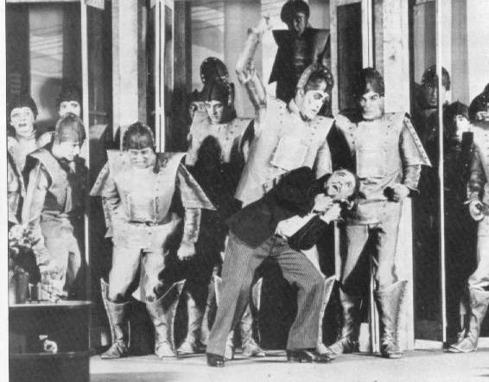
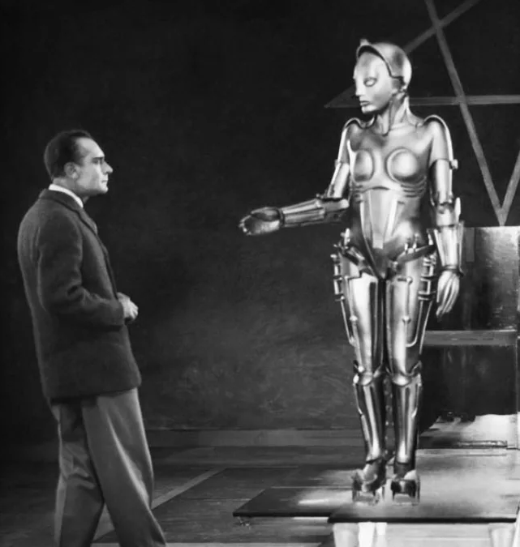
Dreams of Robots
1860s - 1940s
“...the time will come when the machines will hold the real supremacy over the world.” - 1863 article by Samuel Butler
“R.U.R” a 1920 play
1942 Asimov's Laws
A robot may not injure a human being or, through inaction, allow a human being to come to harm.
A robot must obey the orders given it by human beings except where such orders would conflict with the First Law.
A robot must protect its own existence as long as such protection does not conflict with the First or Second Laws.
“Metropolis” a 1927 Silent Film
Notes:
Metoposis
Rossum's Universal Robots https://en.wikipedia.org/wiki/R.U.R.

Slide 6
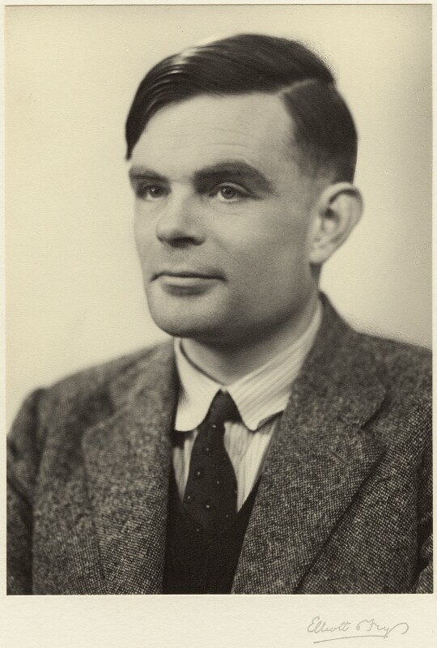
1950 - 1956 Beginnings of Computer Science
Lots of people: What truly is human intelligence?
Alan Turing: How can we decide when a machine has achieved human-level intelligence?
Alan Turing

Slide 7
1950 - 1956 Beginnings of Computer Science
Lots of people: What truly is human intelligence?
Alan Turing: How can we decide when a machine has achieved human-level intelligence?
The politeness convention:
If a machine behaves as intelligently as a human being, then it is as intelligent as a human being
Alan Turing
Notes:
https://en.wikipedia.org/wiki/Philosophy_of_artificial_intelligence

Slide 8
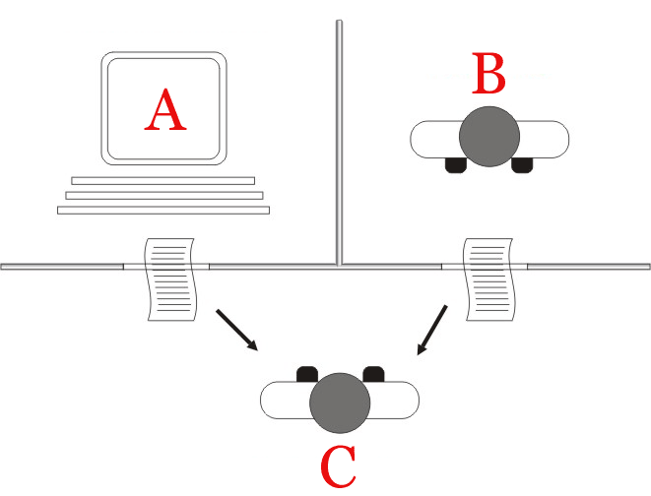
1950 - 1956 Beginnings of Computer Science
The Turing Test 1950
Player C uses natural language typing to hidden players A and B.
Player C attempts to uncover which player is human.
AI has been achieved if player C decides that the machine player is human.
(Turing’s death comes in 1954 at the age of 41 )
Notes:
Image from : https://en.wikipedia.org/wiki/Turing_test

Slide 9
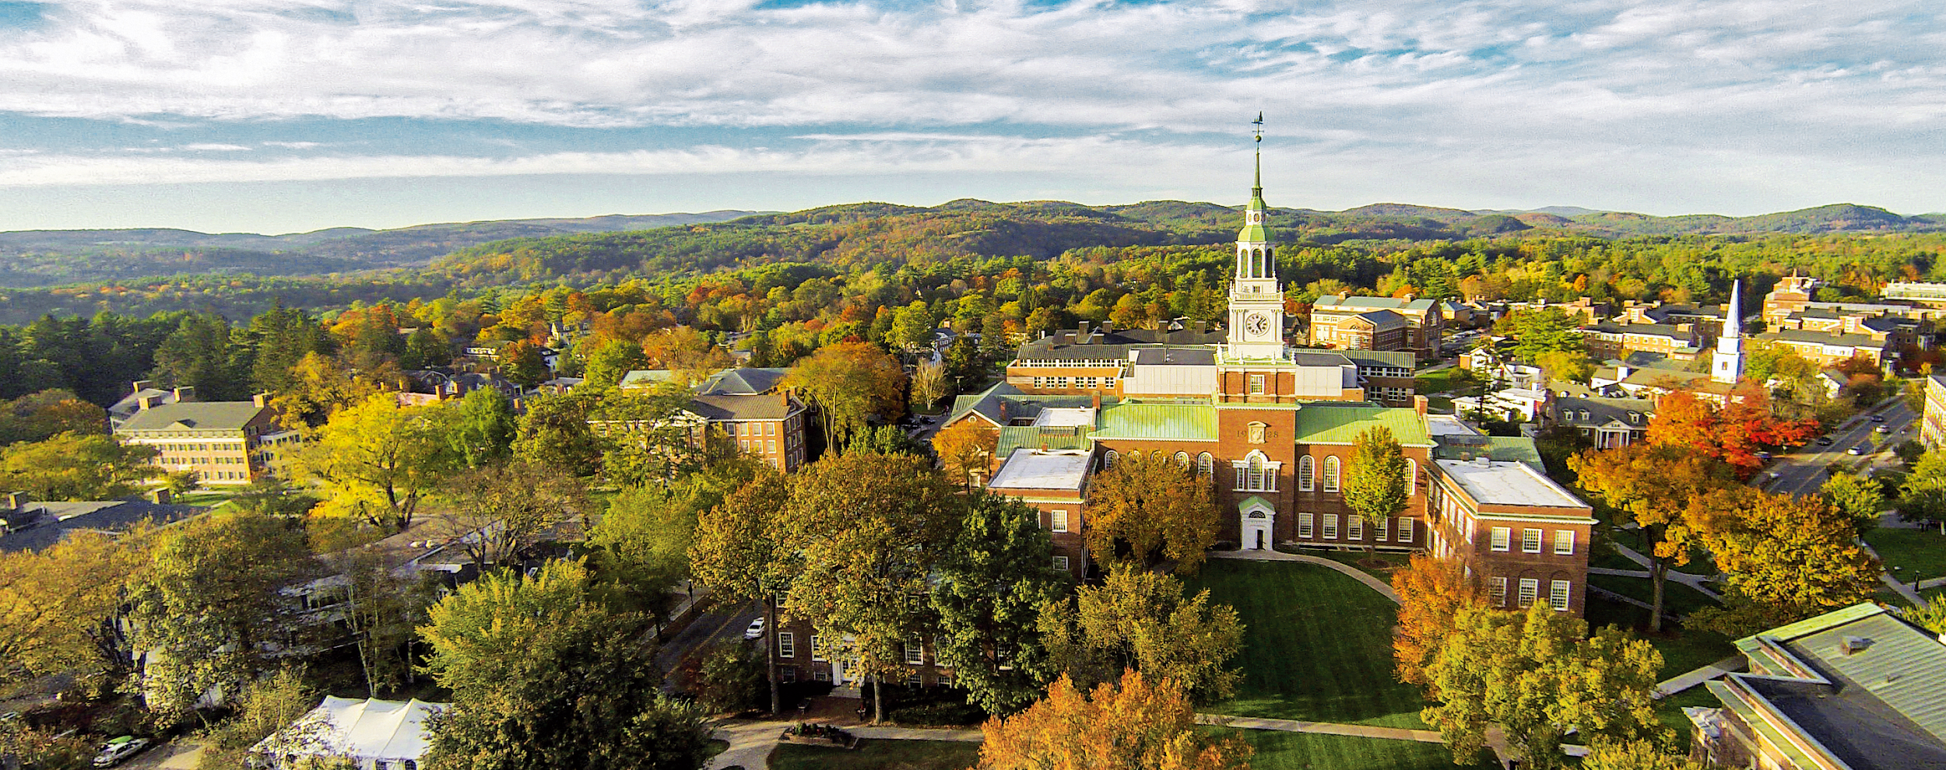
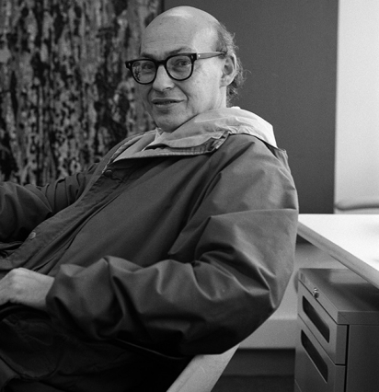
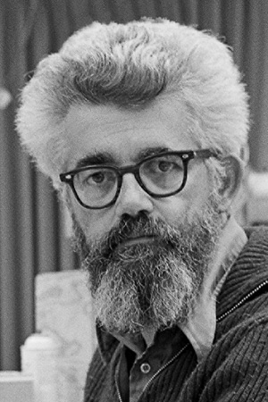
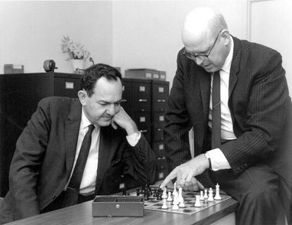
AI Summer Camp: Researchers gather at Dartmouth in 1956 and Artificial Intelligence is born as a field.
Marvin Minsky, MIT
John McCarthy, Dartmouth/ Stanford
Herbert Simon, CMU
Allan Newell, CMU
Notes:
Intelligence can be computationally represented

Slide 10
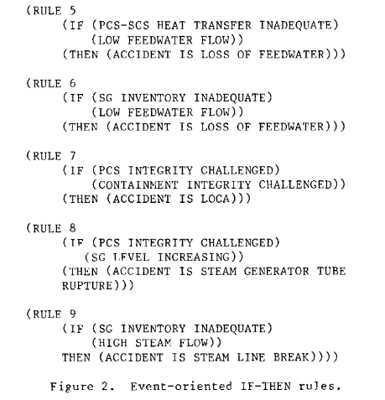
1956 - 1971 We can teach innate knowledge through rules
Symbolism: formal logic systems can represent intelligent action
Notes:
“Every aspect of learning or any other feature of intelligence can be so precisely described that a machine can be made to simulate it.” https://en.wikipedia.org/wiki/Philosophy_of_artificial_intelligence

Slide 11
1956 - 1971 We can teach innate knowledge through rules
Symbolism: formal logic systems can represent intelligent action
Newell & Simon’s “General Problem Solver” can solve math proofs by searching a logic space
Advances in natural language processing based on rules how words relate
Advances in computer vision based on image transforms
Advances in robotics based on rules and search in simplified settings
Notes:
“Every aspect of learning or any other feature of intelligence can be so precisely described that a machine can be made to simulate it.” https://en.wikipedia.org/wiki/Philosophy_of_artificial_intelligence

Slide 12
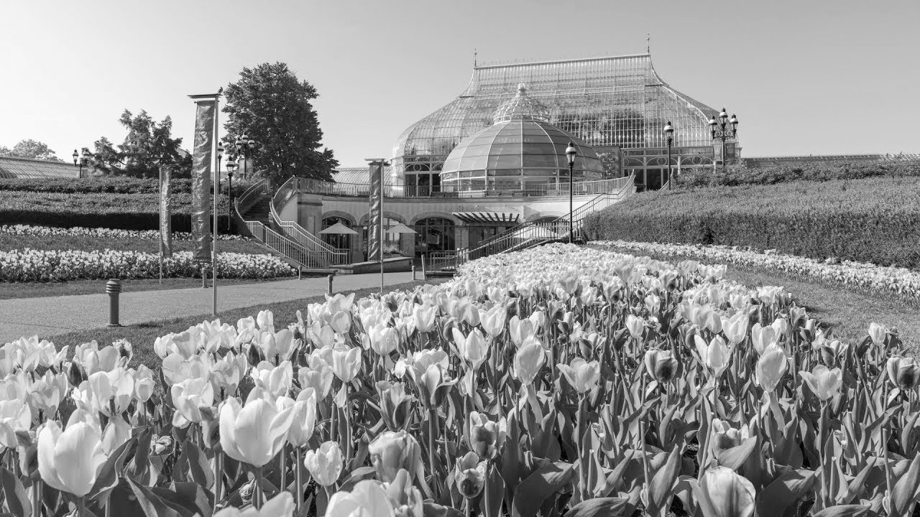
Don’t make promises you can’t keep
"Machines will be capable, within twenty years, of doing any work a man can do” - Herbert Simon 1965
"In from three to eight years we will have a machine with the general intelligence of an average human being." - Minsky 1970
Notes:
Image: https://www.phipps.conservatory.org/

Slide 13
1956 - 1971 We can teach computers to learn
Connectionism: computers should mimic how the brain works
Neurons make thousands of links with other neurons, making trillions of possible connections in the brain
An individual neuron will fire if specific input reaches a certain threshold of electricity, otherwise no
Threshold for a neuron to fire = activation weights in a neural network
Notes:
“Every aspect of learning or any other feature of intelligence can be so precisely described that a machine can be made to simulate it.” https://en.wikipedia.org/wiki/Philosophy_of_artificial_intelligence

Slide 14
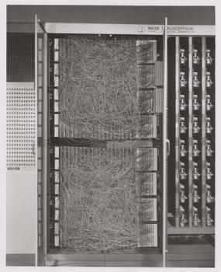
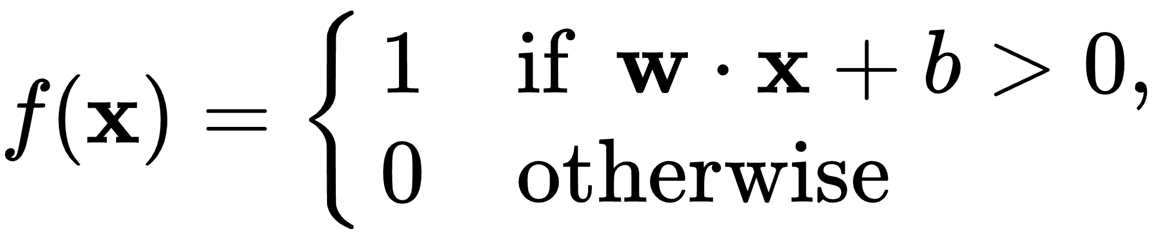
1956 - 1971 We can teach computers to learn
The Perceptron: designed by Frank Rosenblatt 1958
"the embryo of an electronic computer that [the Navy] expects will be able to walk, talk, see, write, reproduce itself and be conscious of its existence." - NYT 1958
Notes:
“Every aspect of learning or any other feature of intelligence can be so precisely described that a machine can be made to simulate it.” https://en.wikipedia.org/wiki/Philosophy_of_artificial_intelligence

Slide 15
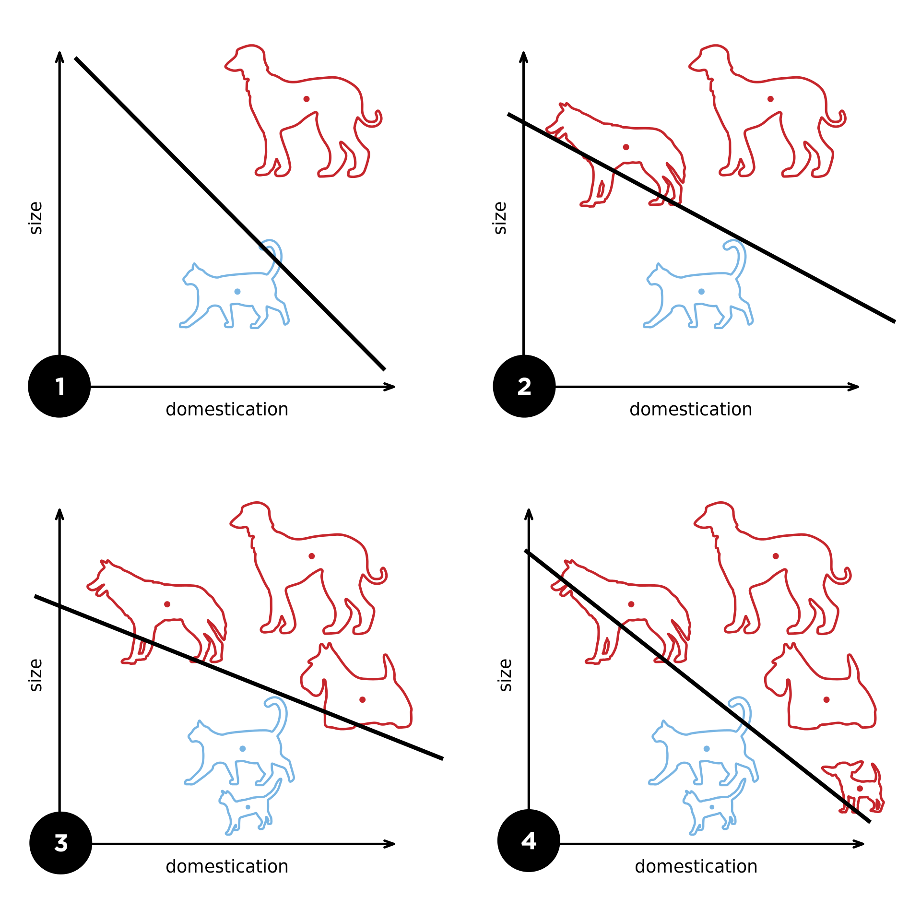
1956 - 1971 We can teach innate knowledge through rules
The Perceptron
Notes:
Image: Perceptron https://commons.wikimedia.org/wiki/File:Perceptron_example.svg

Slide 16
1959 Goodbye: the Perceptron destroyed
Minsky and Seymour Papert publish a book “Perceptrons”
Burn piece of Perceptron approach in favor of rule approach
Perceptron cannot handle XOR operator
Shuts down funding for neural networks
Rosenblatt soon dies, never to see neural nets revindicated

Slide 17
First AI Winter
Funding is lost due to unmet promises
Lighthill Report 1973 shuts down funding in UK
Dreyfus at MIT argues lots of human reasoning is not based on logic rules, involving instinct and unconscious reasoning
(No AI researcher will eat lunch with Dreyfus for the next decade)
Sussman: “using precise language to describe essentially imprecise concepts doesn't make them any more precise.”

Slide 18
First AI Winter
Funding is lost due to unmet promises and fundamental limitations
Computational power of the day limits most applications
Lots of infighting
Limitations with logic rules
All the possibilities
Common sense reasoning
Intractability & Combinatorial Explosion

Slide 19
Limitations with Logic rules: Yale shooting problem
Fred is alive and Alice has a gun
Alice loads the gun
Alice shoots at Fred
She missed
She shot in different direction
She hits in the arm
They’re not at the same location
She thinks she shoots at Fred but it’s a different Fred
It’s a toy gun
The gun broke
Fred was revived, life saved
A dual
Fred is dead
If the first 3 events, is the 4th event true?
Notes:
Representation of knowledge is hard
All the possibilities
Combinatorial explosion and search space
Common sense

Slide 20
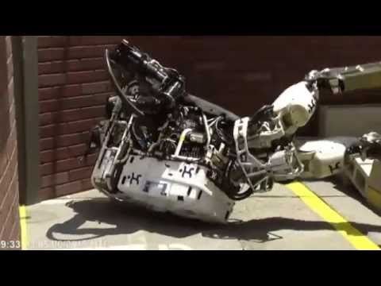
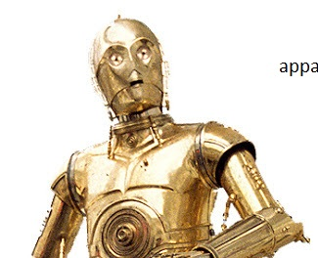
Limitations with Logic rules: Combinatorial Explosion
Example: robot motion planning

Slide 21
1980’s from General Intelligence to Specific Applications
Expert systems: while rules can’t do everything they are useful for capturing what experts do
1989 Deep Thought at CMU can play human-level chess
Again, hype gets too high and funding is lost
Can expert systems capture all expert-knowledge? What are the human-AI implications of expert systems?

Slide 22
1990s - 2000s AI undercover
Many, many, many advances in computer science, probability theory, statistical learning, etc.
“Computer scientists and software engineers avoided the term artificial intelligence for fear of being viewed as wild-eyed dreamers.” - NYT 2005
Machine Learning as a field distances itself from AI

Slide 23
2010s - wait… now we can Machine Learn at scale
Machine learning now immensely powerful
Neural networks now practical, many earlier inventions in neural networks like back propagation in the 1980s are re-discovered
Deep learning gives big performance leaps in almost all application areas overnight
$$$ massive funding is back
What factors in the 2010s enable a resurgence for AI?

Slide 24
2010s - wait… now we can Machine Learn at scale
Machine learning now immensely powerful
Neural networks now practical, many earlier inventions in neural networks like back propagation in the 1980s are re-discovered
Deep learning gives big performance leaps in almost all application areas overnight
$$$ massive funding is back
Why is human-AI interaction now so important?

Slide 25
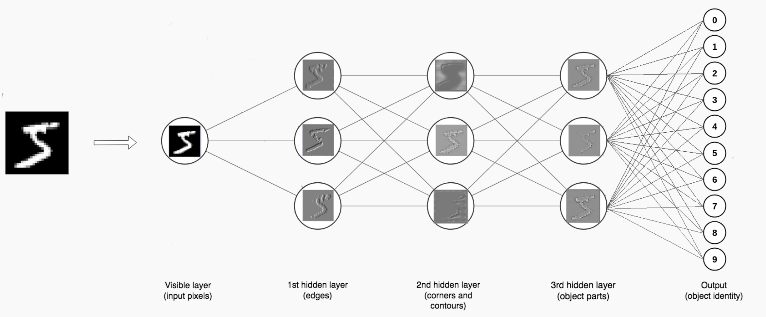
What is a modern neural net vs. the 1970s Perceptron?
Notes:
Image source: https://towardsdatascience.com/comprehensive-introduction-to-neural-network-architecture-c08c6d8e5d98

Slide 26
Thought Exercise:
If machine learning approaches are so good, do we need rule-based approaches anymore?
What advantages and disadvantages does each approach have?
Do realistic applications need both? Or just one, based on the application?

Slide 27
Next Class: History of Human-AI approaches
Reading Assignments & Panels
Piazza
Check in about Assignment #1

